Slide 1
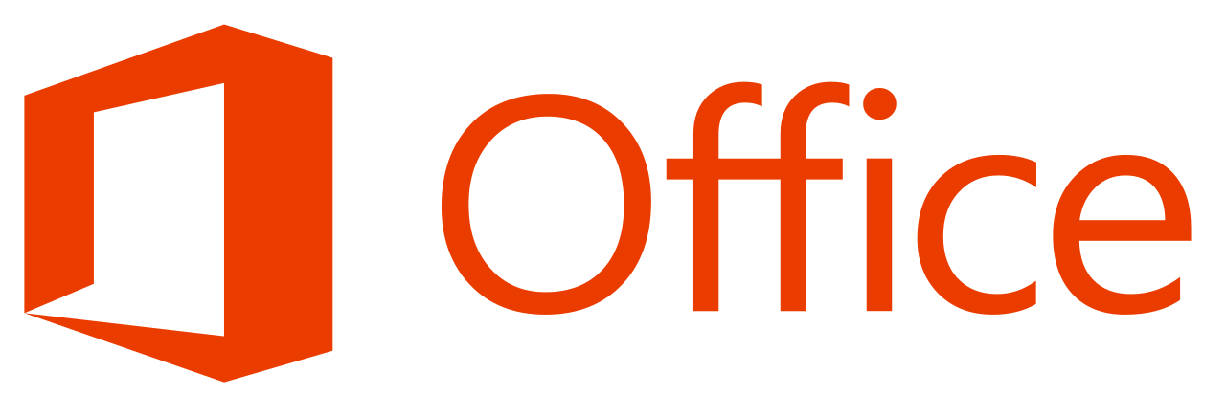
Introduction on MS Office Package and its utilities
Paper Code – BCAN – 181 (Sessional Paper)

Slide 2



What is MS?
Microsoft is a company/corporation in USA.
Bill Gates is the owner of Microsoft Company.

Slide 3
What is Microsoft Office?
Microsoft office is used for special purpose office work such as:
Documentation
Work Sheet
Presentation
Data base.

Slide 4




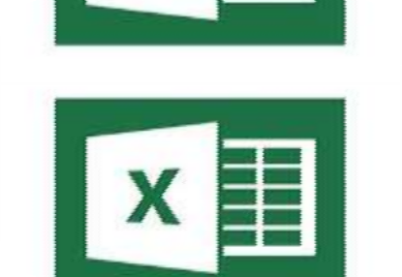


MS-OFFICE HAS FOUR PAKAGES
MS-WORD
MS-EXCEL
MS- POWERPOINT
MS-ACCESS

Slide 5

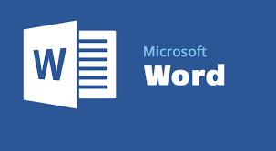
FIRST PACKAGE

Slide 6

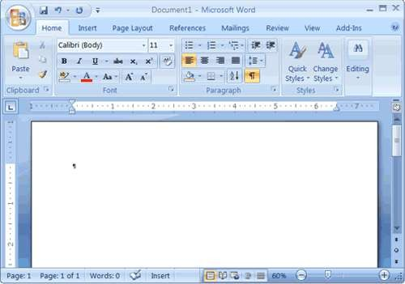
MS-WORD

Slide 7

What is MS-WORD ?
Microsoft Word is a word processing software pakage.
You can use it to type letters ,reports,and other documents.
The four main operations of a word processing pakage are:
Defining the form of the document
Entering a document from a keyboard
Editing (modifying) the document
Printing the document.

Slide 8

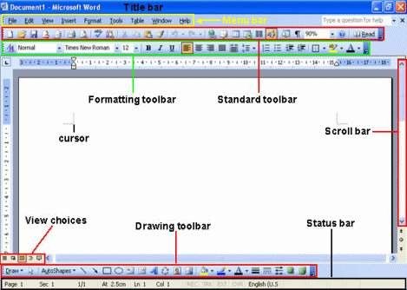
Components of Microsoft Word

Slide 9

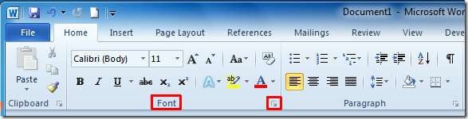
The Ribbon that displays various commands and features of all the tabs

Slide 10

Features of Microsoft Word
Creating Document.
Editing document.
Graphics.
Word Art.
Printing Document.

Slide 11

Proofing Word Document
Spelling Checker
Grammar checker
Thesaurus
Auto correct.

Slide 12

Formatting Word Document
The process to change the appearance of a document is called the document formating you can format a single character, word, lines, paragraph or whole document.
The document is formated to make it more attractive and beautiful.
The commands used to format the document are selected from the Home tab.

Slide 13

Creating Tables
Microsoft word provides a tool called table. It is used to organize information of a rows and columns .
A table is made of series of rows and columns.
The intersection of row and column is called cell.

Slide 14



Slide 15

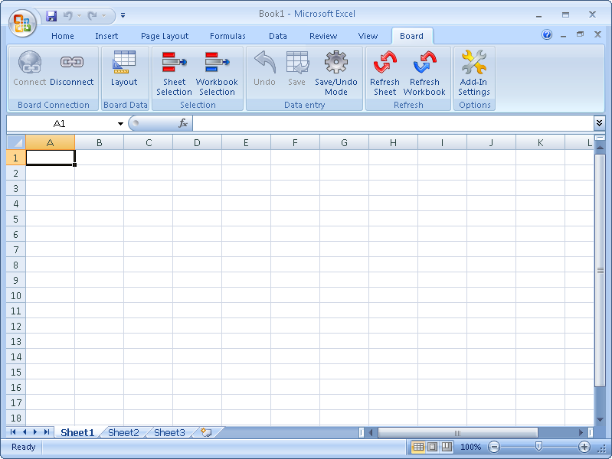
MS-EXCEL

Slide 16

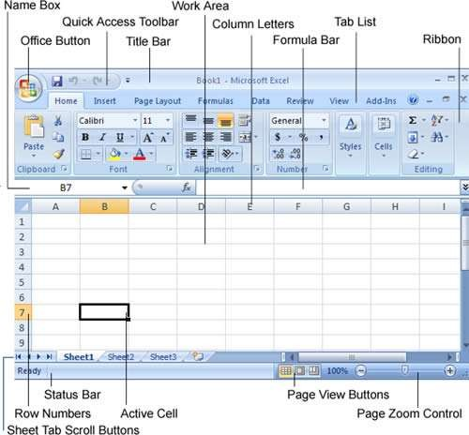
Components of MS-Excel

Slide 17

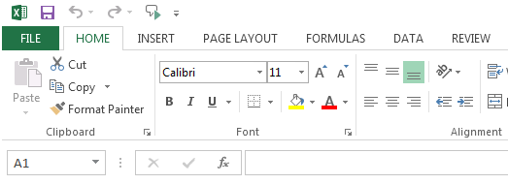
The Ribbon displays various commands and features of all the tabs.

Slide 18
MS-Excel
 Excel is an Microsoft Application that is mainly used
for calculations and mathematical works.
It is a spreadsheet application in which we can add sheets as per our requirements. In a single sheet, it consists of rows and columns and cells, where every cell has different address.
Sum, product, subtraction, division and many mathematical, logical functions are available within it.
Other features include tables, charts, clip art and more.
It is basically used for payroll, accounts, mathematical, and for other business purposes.

Slide 19

Features of MS-Excel
Hyperlink. We can link one file to another file or page.
Clip art. We can add images and also audio and video clips.
Charts. With charts, we can clearly show a product(s) evaluation to a client. For example, you can display a chart showing which product is selling more or less by month, week, and so forth.
Tables. Tables are created with different fields (e.g. name, age, address, roll number, and so forth). You can add a table to fill these values.
Functions. There are both mathematical functions (add, subtract, divide, multiply), and
logical ones (average, sum, mod, product).
Images and backgrounds. You can incorporate images and backgrounds into each sheet.
Macros. Macros are used for recording events for future use.
Database: With the data feature, you can add any database from other sources to it.
Sorting and filtering. We can sort and/or filter our data so that anything redundant or
repetitive can be removed more easily.
Data validations. This tool can help you consolidate your data.
Grouping. The grouping feature helps you both to group your data and ungroup it so that you have subtotals and so forth.
Page layout. Themes, colors, sheets, margins, size, backgrounds, breaks, print, titles, sheets height, width, scaling, grids, headings, views, bring to front of font or back alignment, and many more are available for you to lay out your page.

Slide 20

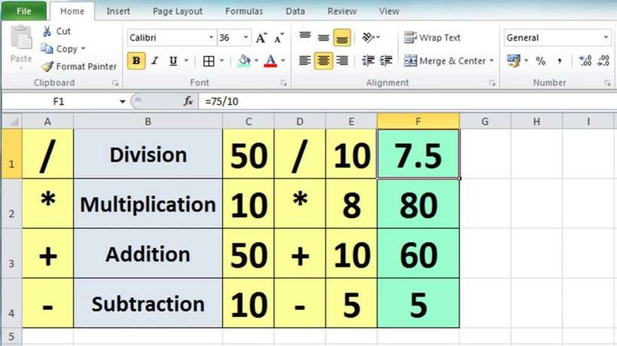
Arithmetic calculation

Slide 21

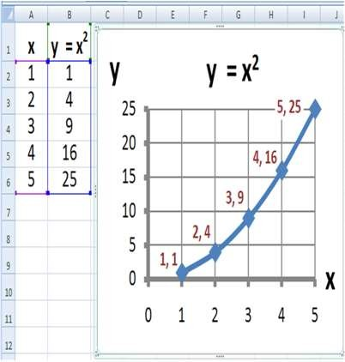
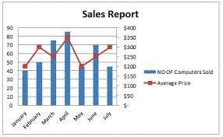
Graphs And Charts

Slide 22

Some Functions of MS-Excel
Average
Count
Pi
Sum
Product
Max
If

Slide 23

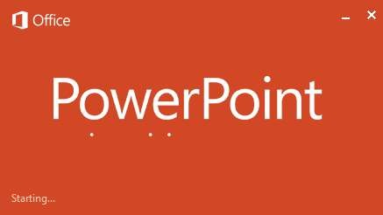

Slide 24

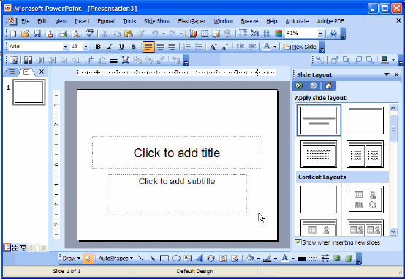
MS-Power point

Slide 25

What is Power Point ?
 PowerPoint is computer software created by Microsoft which allows the user to create slides with recordings, narrations, transitions and other features in order to present information. An example ofPowerPoint is presentation software made by Microsoft.

Slide 26
Features of MS-Power Point
Animatation
Auto shapes
Editing presentation
Spell checking in presentation
Hiding and Un-hiding slides
Running presentation
Slide transition
Saving presentation
Printing presentation

Slide 27



Slide 28
What is MS-ACCESS ?
 MS ACCESS is a tool which used for create database and it is also a application software.

Slide 29
Features of MS-ACCESS
Database
Record
Field
Table
Form
Report
Primary key

Slide 30


Simply
Ms word used for to write documents
Ms excel used for to make spread sheets
Ms PowerPoint for presentations
Ms access for data base management purpose

